Slide 1
SysEng 5211/CompEng 5310/ElecEng 5810 Computational Intelligence
Steven Corns
Introduction

Slide 2
Distribution List
E-mail me your preferred e-mail address
Please provide by August 23rd
Please start all emails with “SE5211”

Slide 3
Text
Fundamentals of Computational Intelligence (Keller, Liu, and Fogel)
Conference papers will be made available for project work

Slide 4
Other Texts
Evolutionary Computation for Modeling and Optimization (Ashlock)
Computational Intelligence – An Introduction (Engelbrecht)

Slide 5
Class Outline
Introduction to Computational Intelligence (CI)
Evolutionary Computation
Fuzzy Systems
Neural Networks
Machine Learning and CI
Applications of CI
See Syllabus—Posted on Canvas

Slide 6
Objectives
Exposure to basic Computational Intelligence Techniques
Survey view across three main areas of CI
Application of Computational Intelligence to a class project

Slide 7
Grading
A—90 and above
B—80-89
C—70-79
D—60-69 (Undergraduate Students)
F—Less than 70 (Graduate Students) or Less than 60 (Undergraduate Students)

Slide 8
Grading
Homework 40%
Final Project*
Presentation 10%
Paper 40%
Professionalism and participation are also considered in grading
* Student assessments are significant portion of the grade

Slide 9
Homework
Two Homework assignments are included in this course, and all deliverables are expected to be turned in on time per the class schedule
An evaluation of at least one other student’s presentation will be required as part of the final project

Slide 10
Expectations
All work will be turned in on time (unless specific situations are previously arranged.)
End of semester peer reviews will be submitted on time—if not-submitted or submitted late a reduction in Class Participation grade will be assessed
Final Presentation evaluations will be submitted on time—late or non-submittals will have Class Participation grade reduced

Slide 11
Lecture Notes
Slides for each module posted to Canvas by ~noon of the day of class
Posted under Files section, Lecture Notes
Syllabus also posted

Slide 12
Introductions
Name
Educational Background
Current/Former Work Experience

Slide 13
Introductions
Educational Background:
BSME, MSME, and PhD Mechanical Engineering
All at Iowa State University
Computational Intelligence, Virtual Engineering and Engineering Optimization
Work Experience
US Navy Nuclear Power Program
-- Mechanical Operator
Department of Energy
-- Modeling, Simulation, and Decision Science
Ames Laboratory
Iowa State University
-- Lecturer, power plant design
Other
Chair of IEEE CIS Bioinformatics and Bioengineering Technical Committee
Finance Chair for IEEE Symposium Series on Computational Intelligence
Member INCOSE MBSE Leadership Team

Slide 14
Final Project
Proposed final project needs instructor approval
Should be a significant body of work
Group work may be acceptable
Can be software or a model/simulation of a distributed system

Slide 15
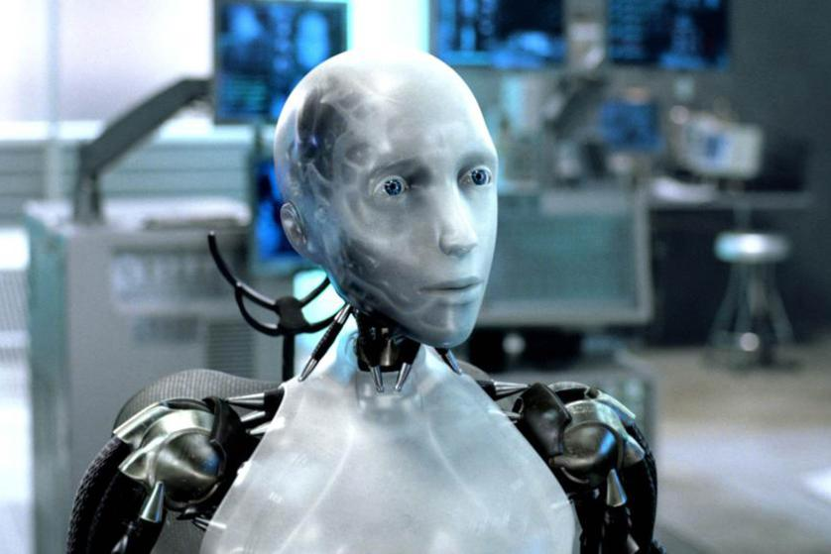
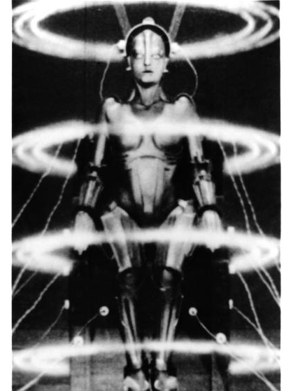
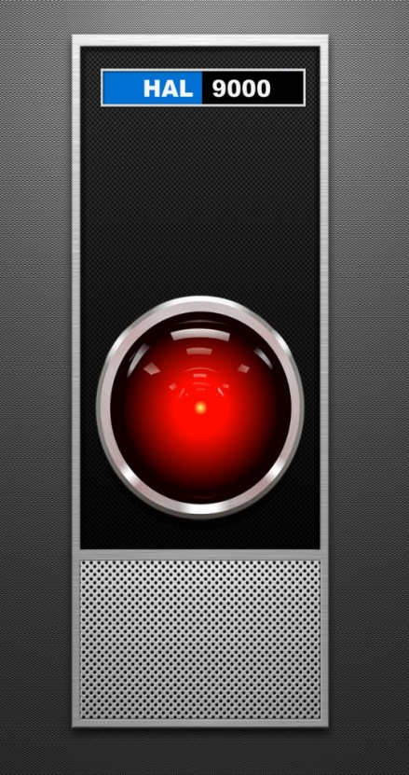
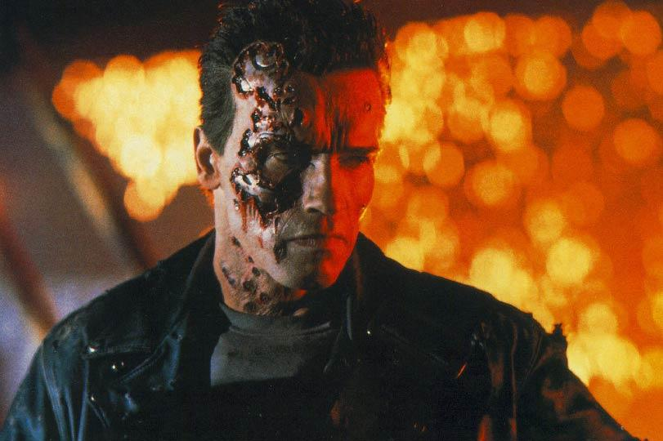


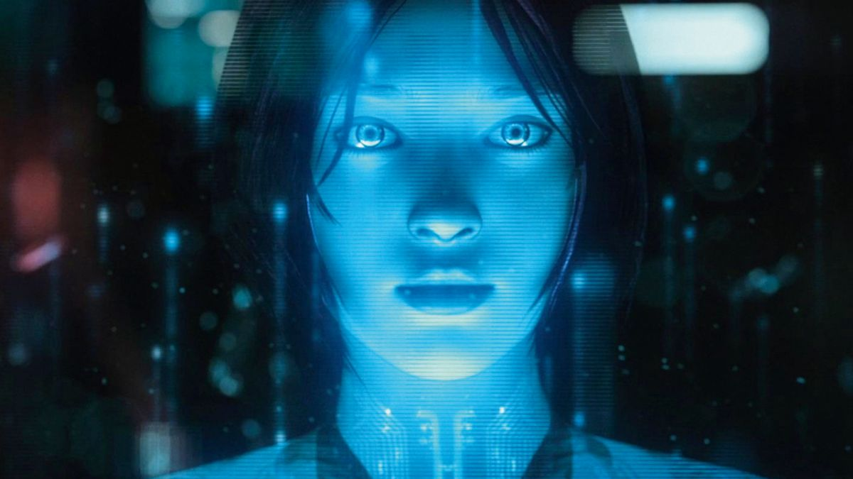
What is Computational Intelligence?

Slide 16
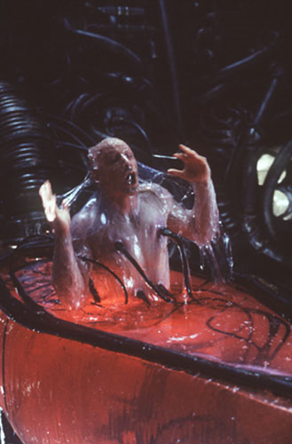
Computational Intelligence will not take over mankind (I don’t think…)
Will provide tools for engineering design and analysis
http://www.notmytribe.com/tag/popular-culture/page/2

Slide 17
Actual Computational Intelligence
Evolutionary Computation
Fuzzy Systems
Neural Networks
Can include
Swarm intelligence
Artificial immune systems
Often coupled with probabilistic models

Slide 18
Commonalities
Heuristics
Naturally Inspired Algorithms
Either
Mimic tasks computers are generally not considered to be ‘good’ at
Do repetitious work that would drive people crazy
Ability to generalize information – can make evaluations of information they have never seen before

Slide 19
Evolutionary Computation
Mimics natural selection
Solutions represented as chromosomes
Best solutions are kept and bad ones are disposed of

Slide 20
Fuzzy Systems
Derived from set theory
Adds uncertainty to otherwise crisp values
Uses nonstatistical uncertainty, not to be confused with statistical uncertainty

Slide 21
Neural Networks
Mimics neurons in the brain
Creates a parallel architecture of simple computational devices

Slide 22
Machine Learning
Getting computers to learn without being explicitly told
Has a basis in probability and regression analysis

Slide 23
Machine Learning
Pattern recognition
Classification and clustering
System controls

Slide 24
Supervised Learning
Machine learning to determine a function describing the relationship between input and output when labeled data is provided
Input vector matched to an output value (supervisory signal)

Slide 25
Unsupervised Learning
Machine learning to determine a relationships between elements of the data with no labels or indication of what the underlying relationships may be.
Typically used for clustering and associative reasoning

Slide 26
Applications
Bioinformatics/Biomedical
Manufacturing
Logistics
Power/Electrical/Utilities
Security
Games

Slide 27
Organizations
IEEE Computational Intelligence Society
International Society for Genetic and Evolutionary Computation
International Neural Network Society
Association for Computing Machinery

Slide 28
IEEE Computational Intelligence Society
Hosts annual conferences in all three areas of CI
Congress on Evolutionary Computation (CEC)
International Joint Conference on Neural Networks (IJCNN)
Fuzzy Systems (FUZZ-IEEE) International Conference
Every other year these are combined in a World Congress of Computational Intelligence (WCCI)

Slide 29
IEEE Computational Intelligence Society
Also host symposium series on Computational Intelligence
One event with about 30 CI Symposia
CIS has another six symposia that it sponsors or co-sponsors

Slide 30
International Society for Genetic and Evolutionary Computation
Sponsors “Genetic and Evolutionary Computation Conference (GECCO)

Slide 31
International Neural Network Society
Sponsors International Joint Conference on Neural Networks in partnership with IEEE CIS

Slide 32
Association for Computing Machinery
Co-sponsors IJCNN with IEEE-CIS
In addition, sponsors at least six other conferences per year

Slide 33
Moving Forward
Start looking at sources for final project
Final project may be inspired by a paper you read or it could be related to your research

Slide 34
Program Completed
Missouri University of Science & Technology
© 2003 Curators of University of Missouri

